Slide 1
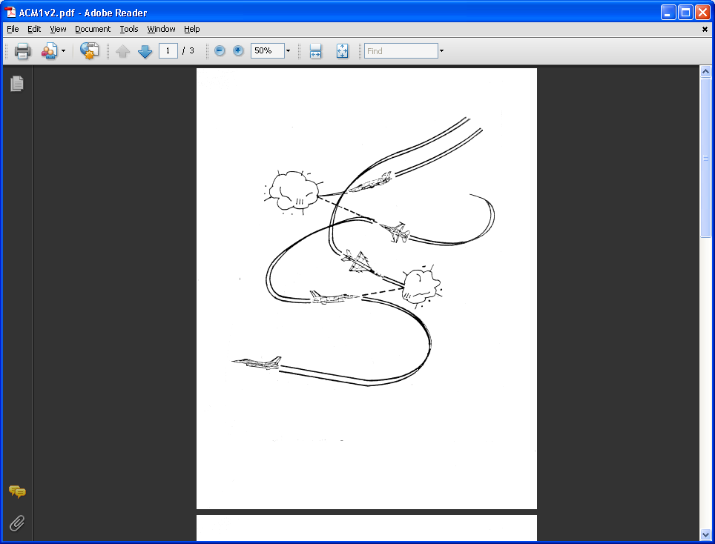
AE 317 Flight Mechanics and Performance
Bernoulli’s, Airspeeds, Speed of Sound/Mach, Std. Atm., and Lift
LECTURE 03
Dr. Jeff Ashworth
Aerospace Engineering Department

Slide 2
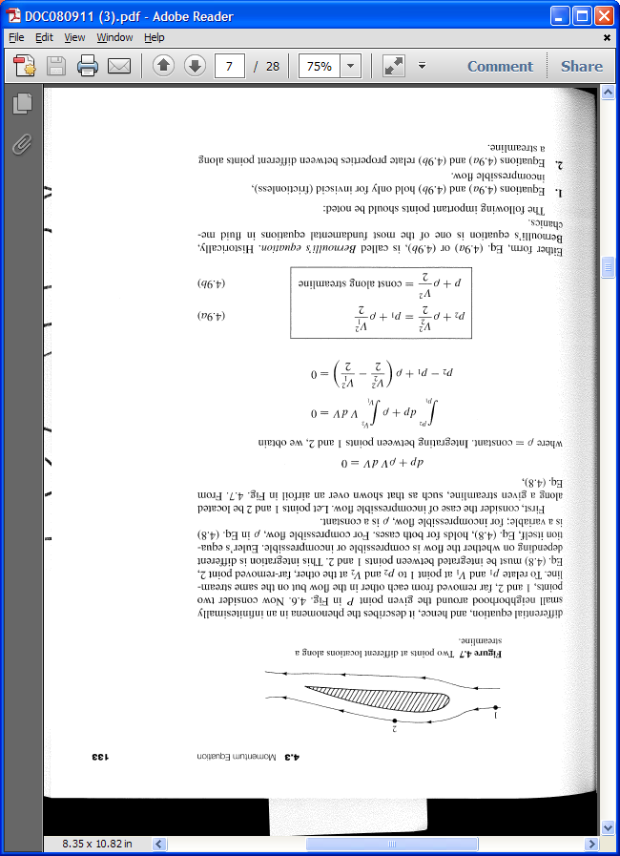
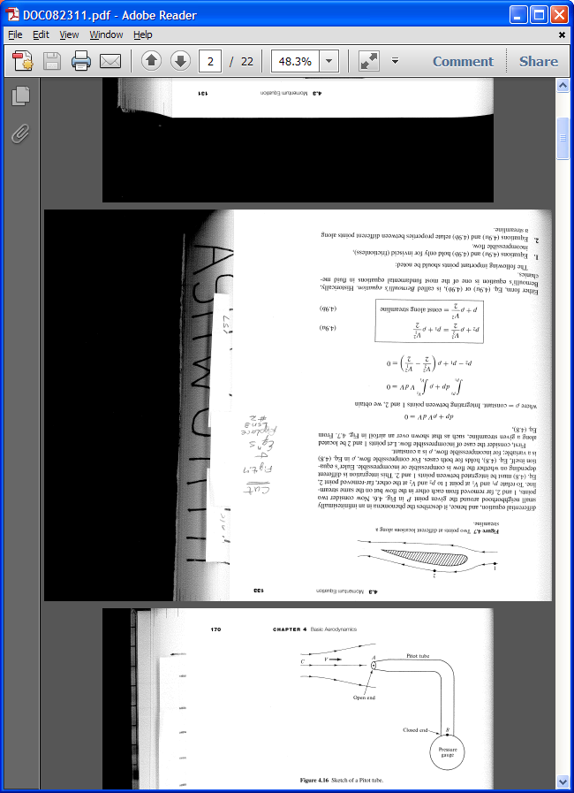
(Anderson)

Slide 3
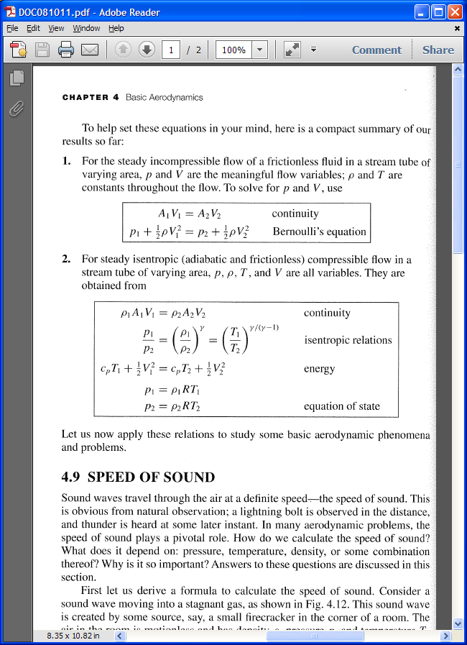
(Anderson)

Slide 4
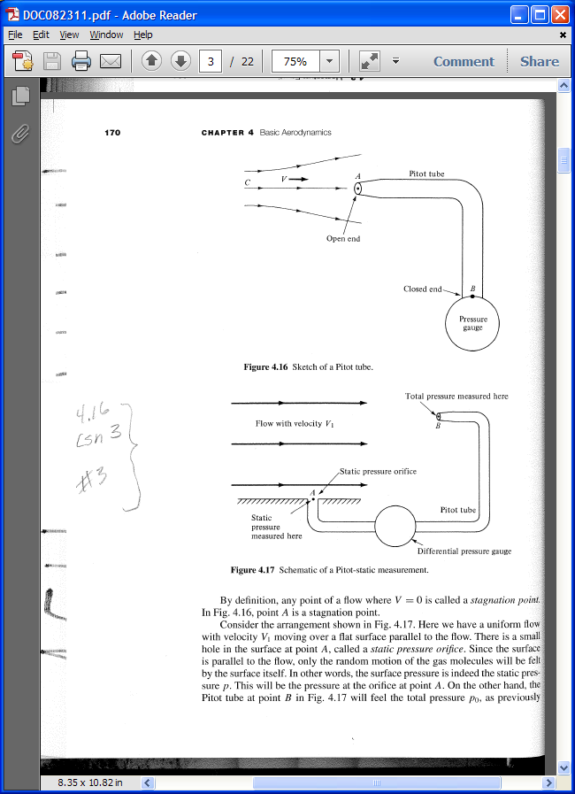
(Anderson)

Slide 5
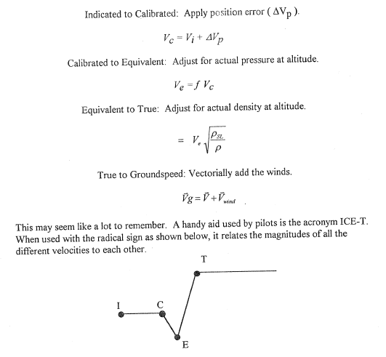
(Brandt)

Slide 6
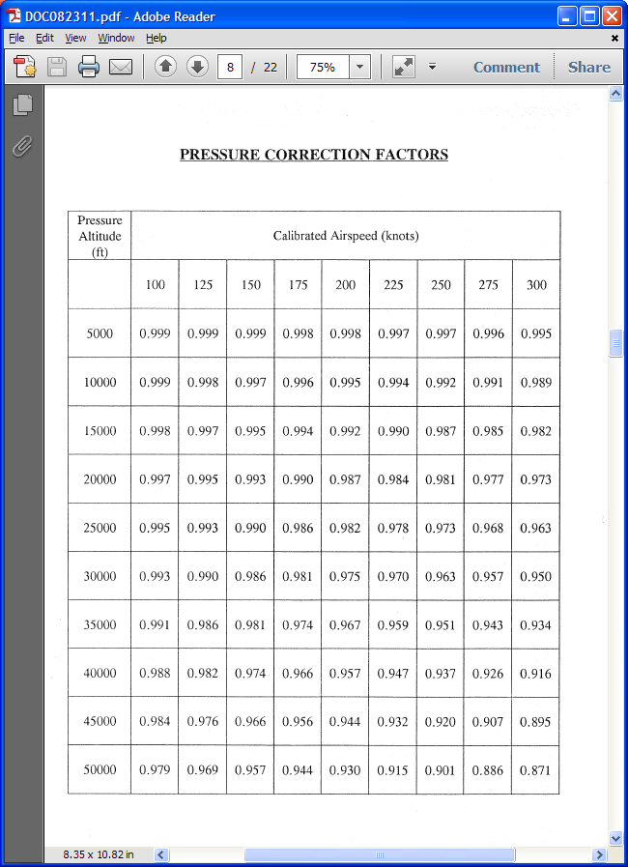
(Brandt)

Slide 7
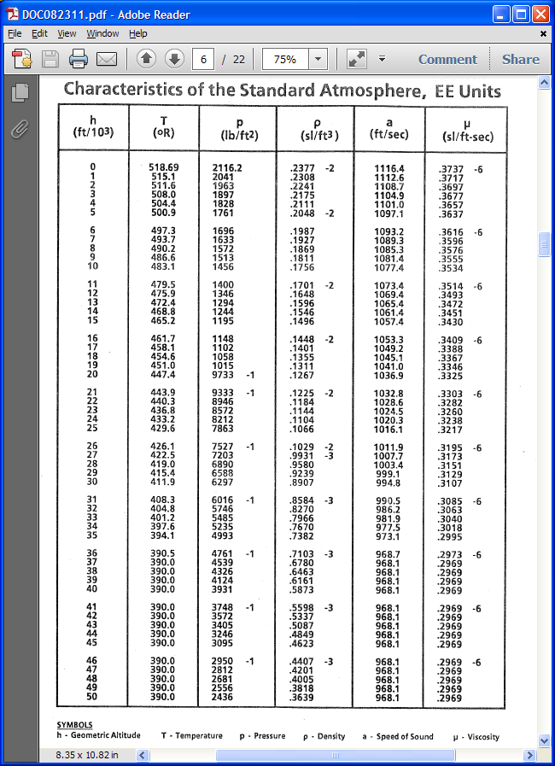
(Brandt)

Slide 8
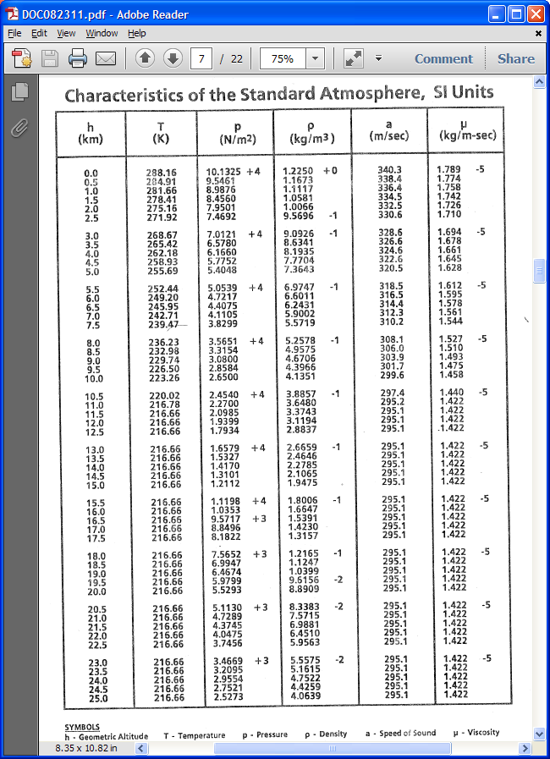
(Brandt)

